Slide 1
Classification and reconstruction of optical quantum states with deep neural networks
Shahnawaz Ahmed, Carlos S´anchez Mu˜noz, Franco Nori and Anton Frisk Kockum

Slide 2
Task
Classification an unknown quantum state
Reconstructed quantum state

Slide 3
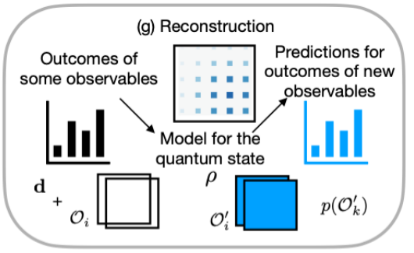
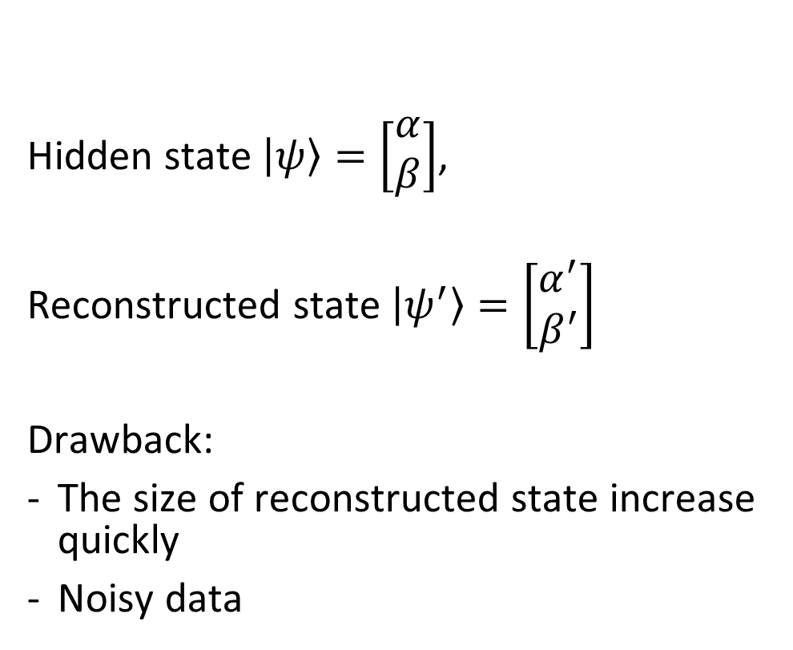
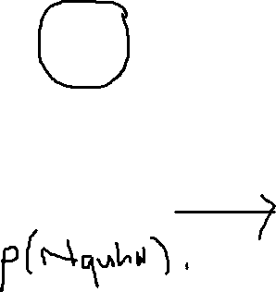
Quantum state tomography
Hidden state $\left|ψ\right\rangle =\left[\begin{matrix}α \\ β\end{matrix}\right]$,
Reconstructed state $\left|ψ^{′}\right\rangle =\left[\begin{matrix}α^{′} \\ β^{′}\end{matrix}\right]$
Drawback:
The size of reconstructed state increase quickly
Noisy data

Slide 4
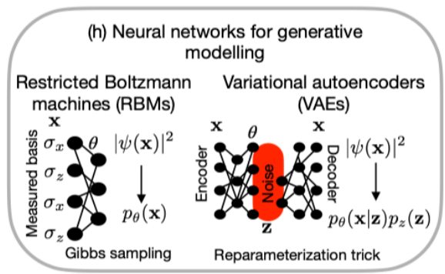
Overview: model
Restricted Boltzmann machine (RBM)
Variation autoencoder (VAE)

Slide 5
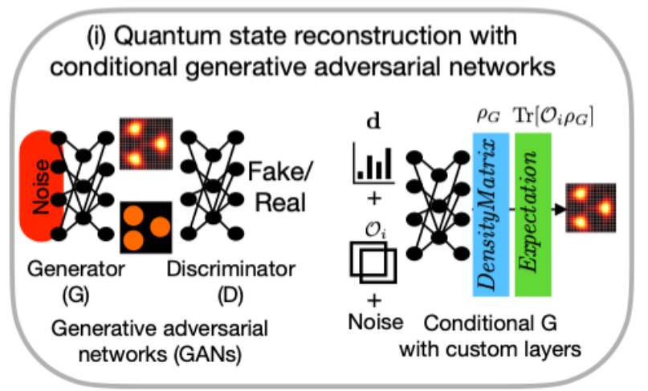
Overview: model
Generative adversarial networks (GAN)

Slide 6
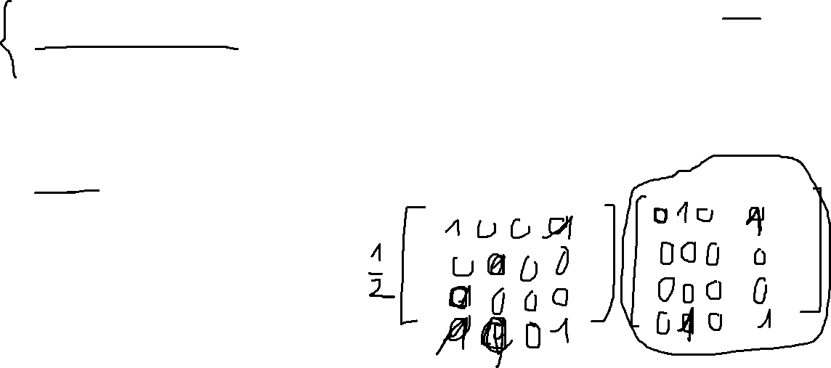
Overview: drawbacks
Greenberger-Horne-Zeilinger (GHZ) states, which only contain four non-zero elements in the density matrix -> Hard to determind position of such elements?
The lack of quantum-mechanical constraints on the reconstructed state
Noise

Slide 7

Overview: proposed method
Quantum state tomography – Conditional Generative adversarial Network (QST-CGAN):
Combine VAE and GAN
New loss function

Slide 8

Contents
II. Background
III. Data
Optical quantum state
Measurements
Noise
IV. Methods
Classification
Reconstruction
V. Results

Slide 9
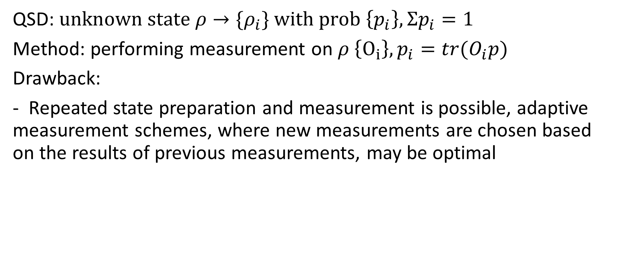
II. A. Quantum state discriminator (QSD)
QSD: $unknown state ρ→{\{ρ}_{i}\} with prob \left\{p_{i}\right\}, Σp_{i}=1$
Method: performing measurement on $ρ \left\{O_{i}\right\}, p_{i}=tr(O_{i}p)$
Drawback:
- Repeated state preparation and measurement is possible, adaptive measurement schemes, where new measurements are chosen based on the results of previous measurements, may be optimal

Slide 10
II. B. Quantum state tomography

Slide 11
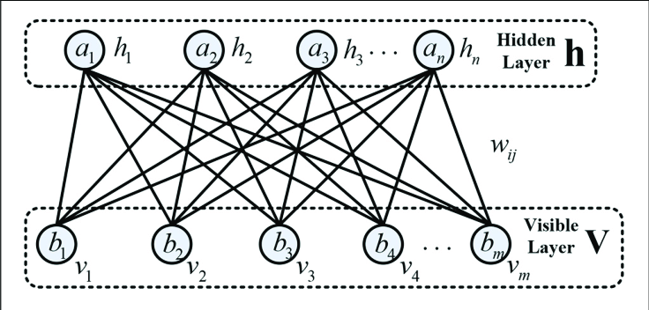
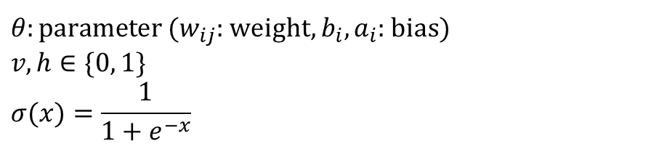
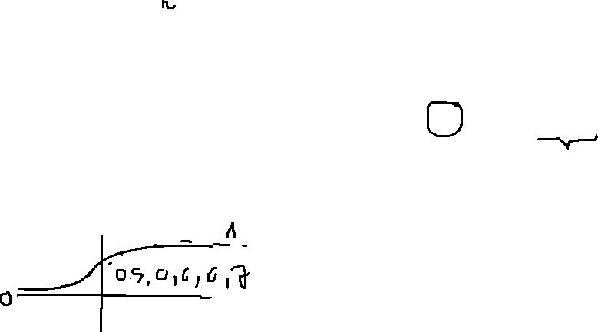
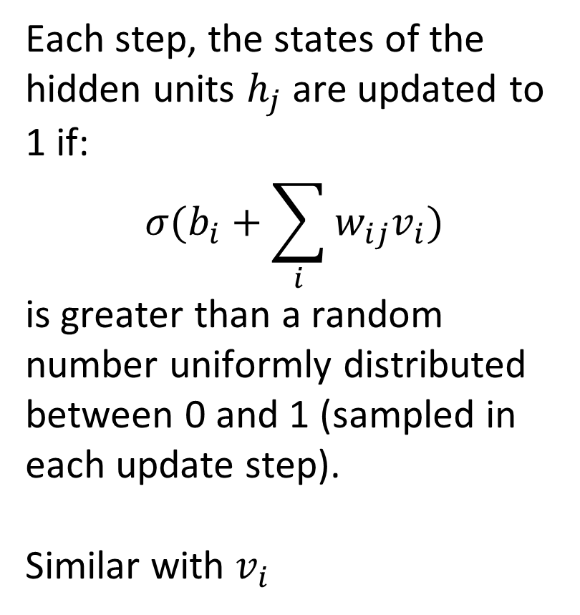
1. Restricted Boltzmann machine
Each step, the states of the hidden units $h_{j}$ are updated to 1 if:
$$σ(b_{i}+\sum_{i}{w_{ij}v_{i}})$$
is greater than a random number uniformly distributed between 0 and 1 (sampled in each update step).
Similar with $v_{i}$
${θ:parameter (w}_{ij}$: weight, $b_{i},a_{i}$: bias)
$$v,h∈\{0, 1\}$$
$$σ(x)=\frac{1}{1+e^{−x}}$$

Slide 12
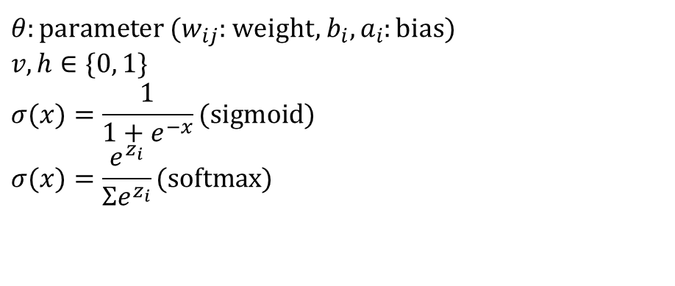
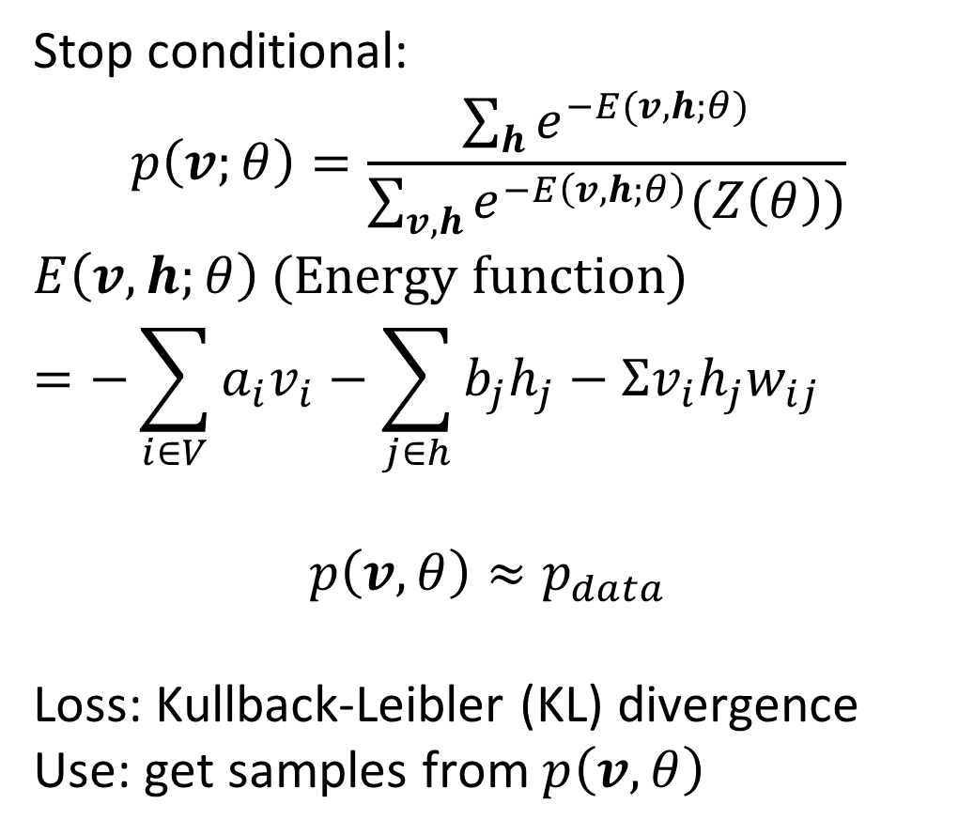
1. Restricted Boltzmann machine
Stop conditional:
$$p\left(v;θ\right)=\frac{\sum_{h}{e^{−E(v,h;θ)}}}{\sum_{v,h}{e^{−E\left(v,h;θ\right)}(Z\left(θ\right))}}$$
$E\left(v,h;θ\right)$ (Energy function)
$$=−\sum_{i∈V}{a_{i}v_{i}}−\sum_{j∈h}{b_{j}h_{j}}−Σv_{i}h_{j}w_{ij}$$
$$p\left(v,θ\right)≈p_{data}$$
Loss: Kullback-Leibler (KL) divergence
Use: get samples from $p\left(v,θ\right)$
${θ:parameter (w}_{ij}$: weight, $b_{i},a_{i}$: bias)
$$v,h∈\{0, 1\}$$
$$σ(x)=\frac{1}{1+e^{−x}}(sigmoid)$$
$$σ(x)=\frac{e^{z_{i}}}{Σe^{z_{i}}}(softmax)$$

Slide 13
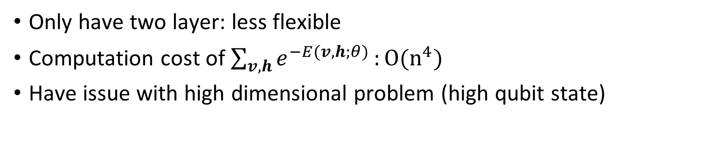
1. Restricted Boltzmann machine
Only have two layer: less flexible
Computation cost of $\sum_{v,h}{e^{−E(v,h;θ)}}:O(n^{4})$
Have issue with high dimensional problem (high qubit state)

Slide 14
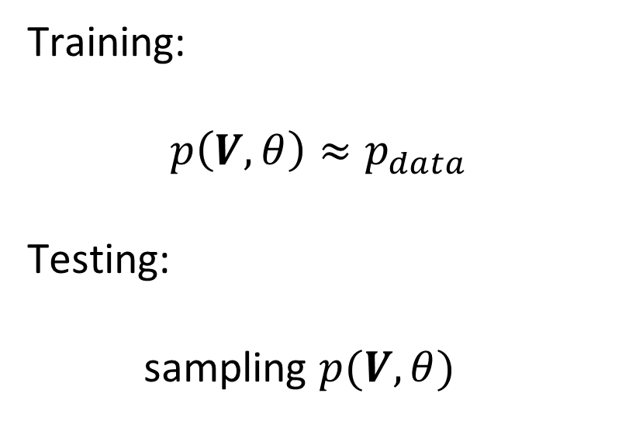
1. Restricted Boltzmann machine
Training:
$$p\left(V,θ\right)≈p_{data}$$
Testing:
sampling $p(V, θ)$
${θ:parameter (w}_{ij}$: weight, $b_{i},a_{i}$: bias)
$$v,h∈\{0, 1\}$$
$$σ(x)=\frac{1}{1+e^{−x}}$$

Slide 15
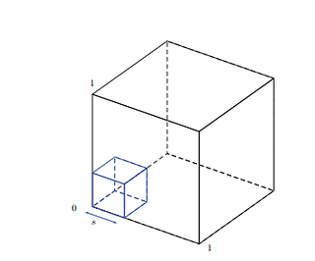
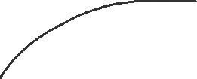
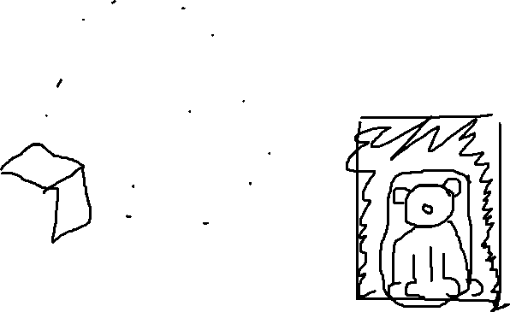
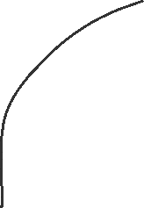
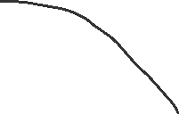

2. VAE
Noise
…
Essential characterization

Slide 16
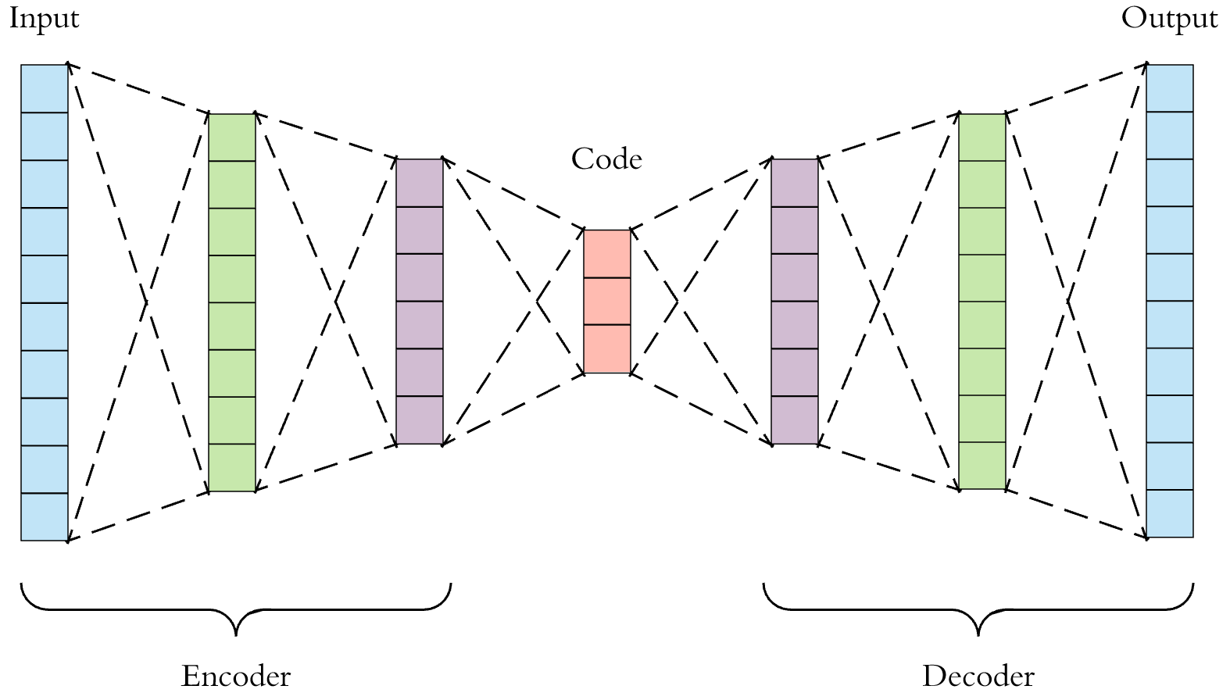
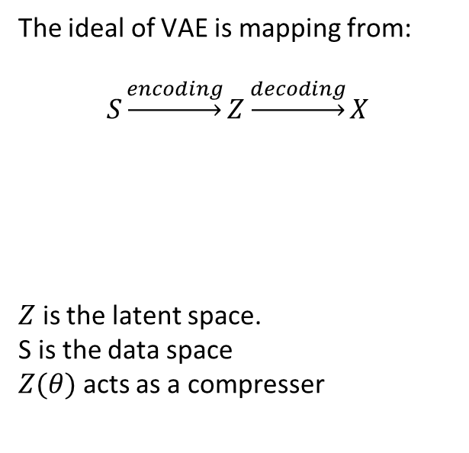

2. Variantional auto encoder: VAE
The ideal of VAE is mapping from:
$$S\underset{→}{encoding}Z\underset{→}{decoding}X$$
$Z$ is the latent space.
S is the data space
$Z(θ)$ acts as a compresser
x
z

Slide 17
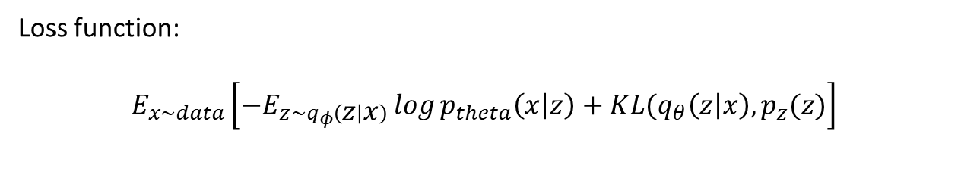
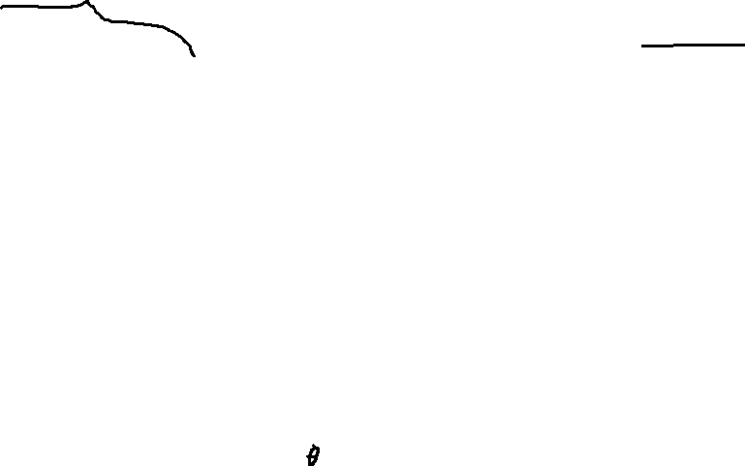
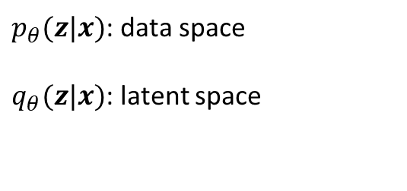
2. Variantional auto encoder: VAE
$p_{θ}(z|x)$: data space
$q_{θ}(z|x)$: latent space
x
z
Loss function:
$$E_{x\sim data}\left[−E_{z\sim q_{φ}\left(z | x\right)}\log{p_{theta}\left(x | z\right)}+KL(q_{θ}\left(z | x\right),p_{z}(z)\right]$$

Slide 18




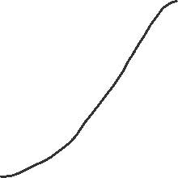

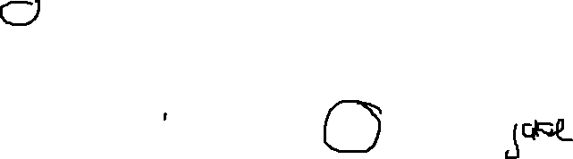

2. Variantional auto encoder: VAE
Latent space $Z(θ)$
Reconstructed state’s generated from latent vector z
z
Distribution’s generated from latent space Z
x
Loss function:
$$E_{x\sim data}\left[−E_{z\sim q_{φ}\left(z | x\right)}\log{p_{theta}\left(x | z\right)}+KL(q_{θ}\left(z | x\right),p_{z}(z)\right]$$
Distribution’s generated from latent space Z
Decoder loss
Encoder loss

Slide 19
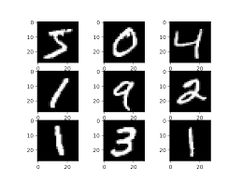
2. VAE: Example
Assume that we need to compress an MNIST instance from a matrix to a 2-D point.

Slide 20
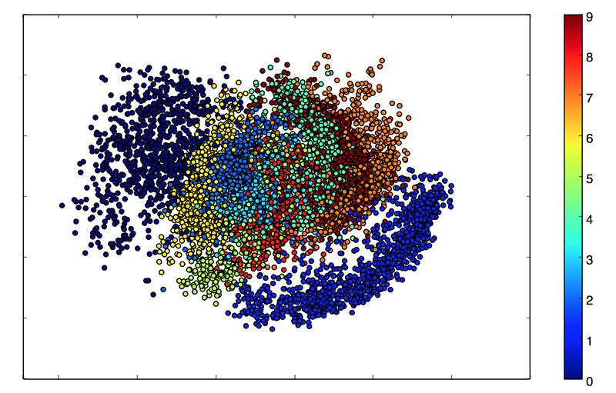
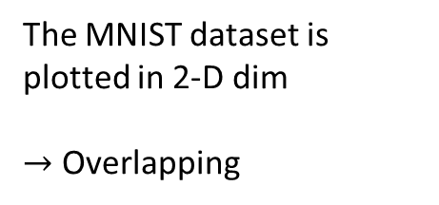
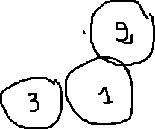
2. VAE: Example
The MNIST dataset is plotted in 2-D dim
$→$ Overlapping

Slide 21
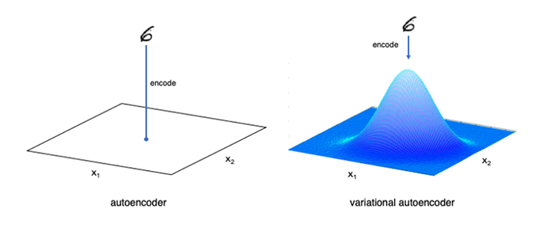
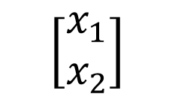
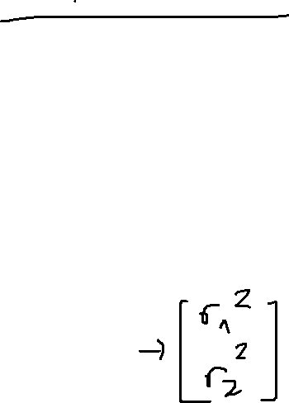
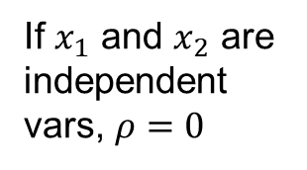
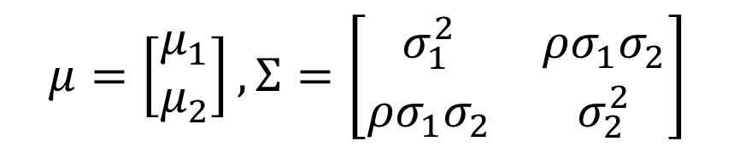
2. VAE: Example
If $x_{1}$ and $x_{2}$ are independent vars, $ρ=0$
$$\left[\begin{matrix}x_{1} \\ x_{2}\end{matrix}\right]$$
$$μ=\left[\begin{matrix}μ_{1} \\ μ_{2}\end{matrix}\right],Σ=\left[\begin{matrix}σ_{1}^{2} & ρσ_{1}σ_{2} \\ ρσ_{1}σ_{2} & σ_{2}^{2}\end{matrix}\right]$$

Slide 22
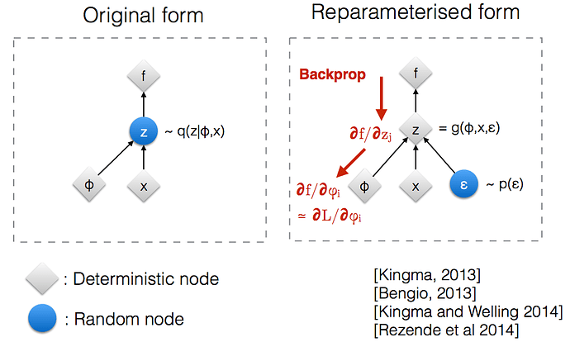
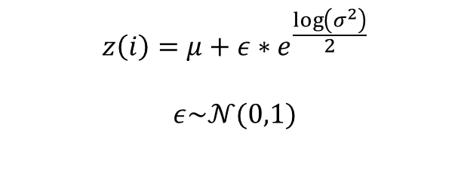
2. Variantional auto encoder: VAE
Latent space $Z(θ)$
$$z\left(i\right)=μ+ε∗e^{\frac{\log\left(σ^{2}\right)}{2}}$$
$$ε\sim 𝒩(0,1)$$
x
z

Slide 23
2. VAE
Overfitting: not the best for representing natural data distributions

Slide 24
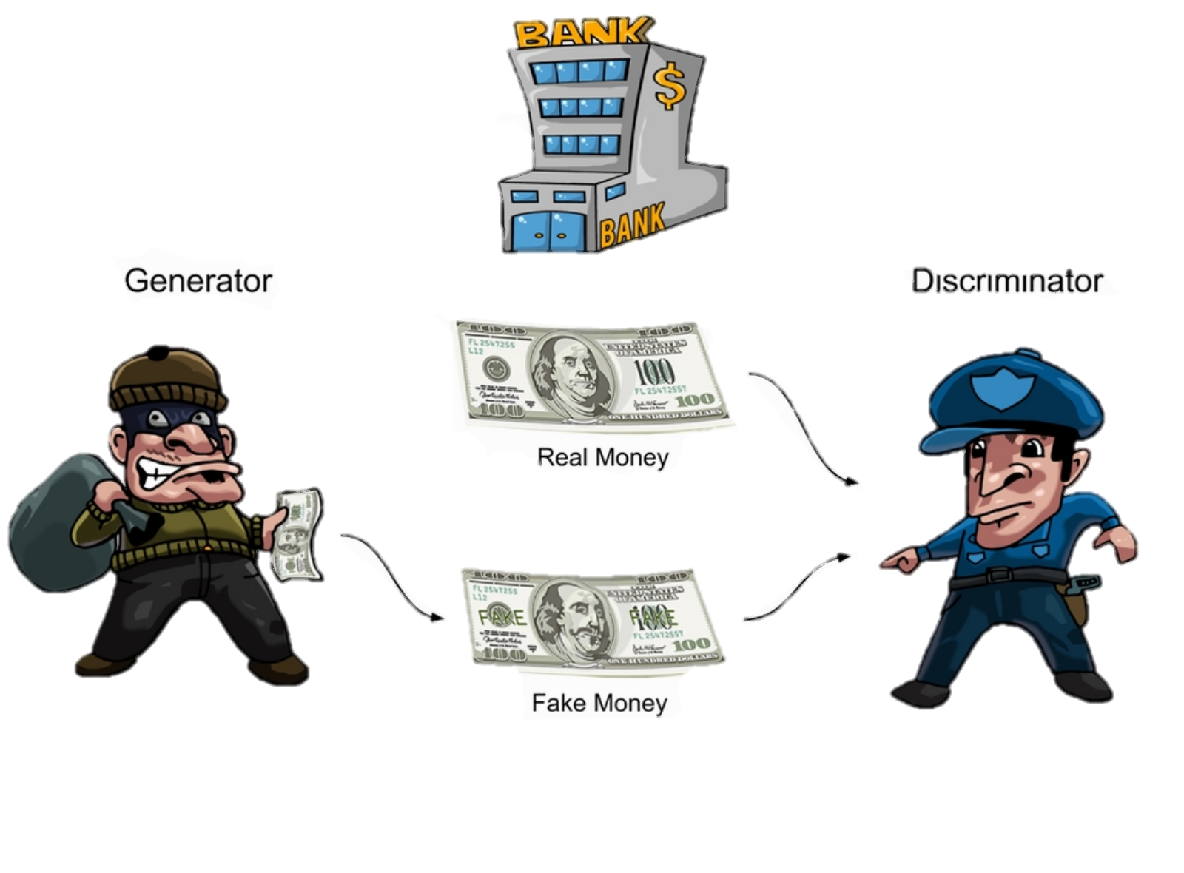

3. GAN

Slide 25
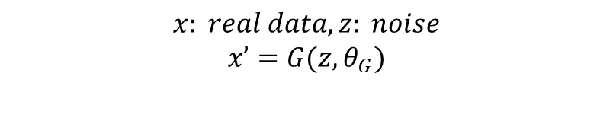
3. GAN
$$x: real data, z: noise$$
$$x’=G(z, θ_{G})$$
Loss function: $\min_{G}{\max_{D}{(E_{x\sim p_{data}}[log⁡(D\left(x, θ_{D}\right))]+E_{z\sim p_{fake}}[\log\left(1−D\left(G\left(z,θ_{G}\right), θ_{D}\right)\right)])}}$
Loss function was upgrade in WGAN, WGAN-GP, …

Slide 26
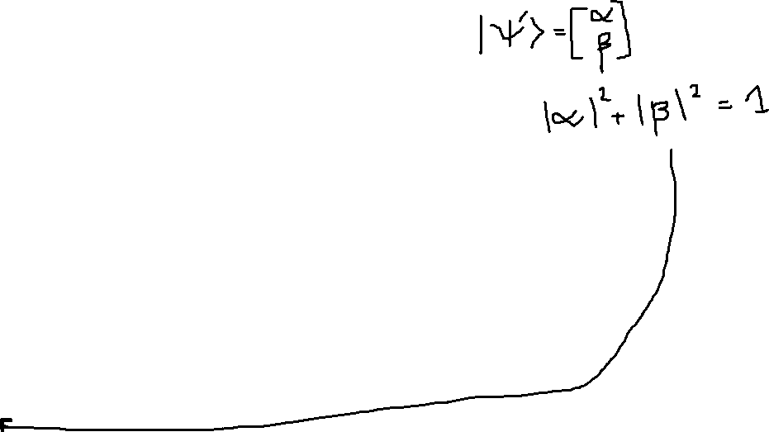
3. Condiational GAN - CGAN
c
c

Slide 27

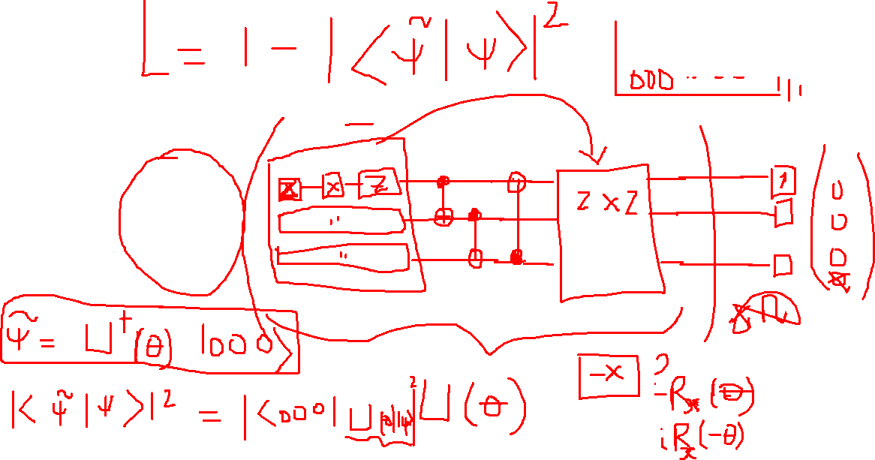

Slide 28
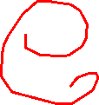
III. Data
Optical quantum state
Measurements
Noise

Slide 29

A. Optical quantum state
$$\left|ψ\right\rangle =\sum_{n=0}^{N−1}{c_{n}|n⟩}$$
N: size of Hibert space
n: photon number
Pure and mixed states are represented as N × N density matrices $ρ$

Slide 30

C. Noise
Noise from:
Data preparation: $ρ→ρ_{noisy}$
Measurement: $\left\{𝒪\right\}→\left\{𝒪_{noisy}\right\}$
Data collection: $d→d_{noisy}$

Slide 31

1. Mixed state
$ρ_{mixed}=\left(1−σ\right)ρ+σp_{random}$. $σ∈[0,0.05]$
In reconstructed task, aim is $p_{mixed}$

Slide 32
II. C. Discriminative and generative modeling

Slide 33
D. Neural networks as discriminative and generative models

